Slide 1
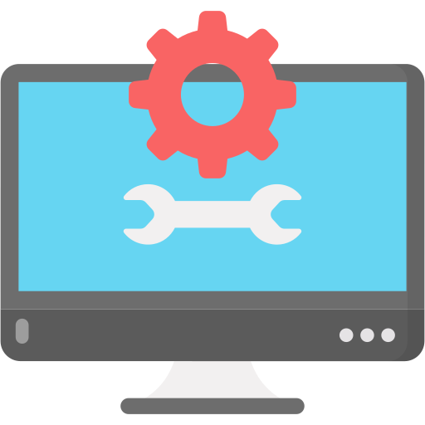
PC Hardware and Support Fundamentals
Lecture : 7

Slide 2

Table of Contents-
Explain the Operation of a Motherboard and Its Components, Types and Features

Slide 3

Operation of a Motherboard
Components,
Types and
Features

Slide 4

Introduction

Slide 5
Introduction
Imagine a world without computers. Our lives would be vastly different, as computers have become an integral part of our daily routines. But have you ever wondered how these machines function?
Behind the sleek exterior lies a crucial component known as the motherboard.
It serves as the central nervous system of a computer, connecting and controlling various other components.
Today, we will delve into the fascinating world of motherboards and explore their operation, components, types, and features.

Slide 6
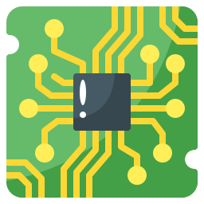
Background Information
The motherboard, also called the mainboard or system board, is a fundamental piece of hardware that serves as the foundation for a computer system.
It is a printed circuit board (PCB) that provides a platform for all other components to connect and communicate with each other.
Without a motherboard, a computer would be nothing more than a collection of individual parts.

Slide 7
Understanding the Motherboard

Slide 8
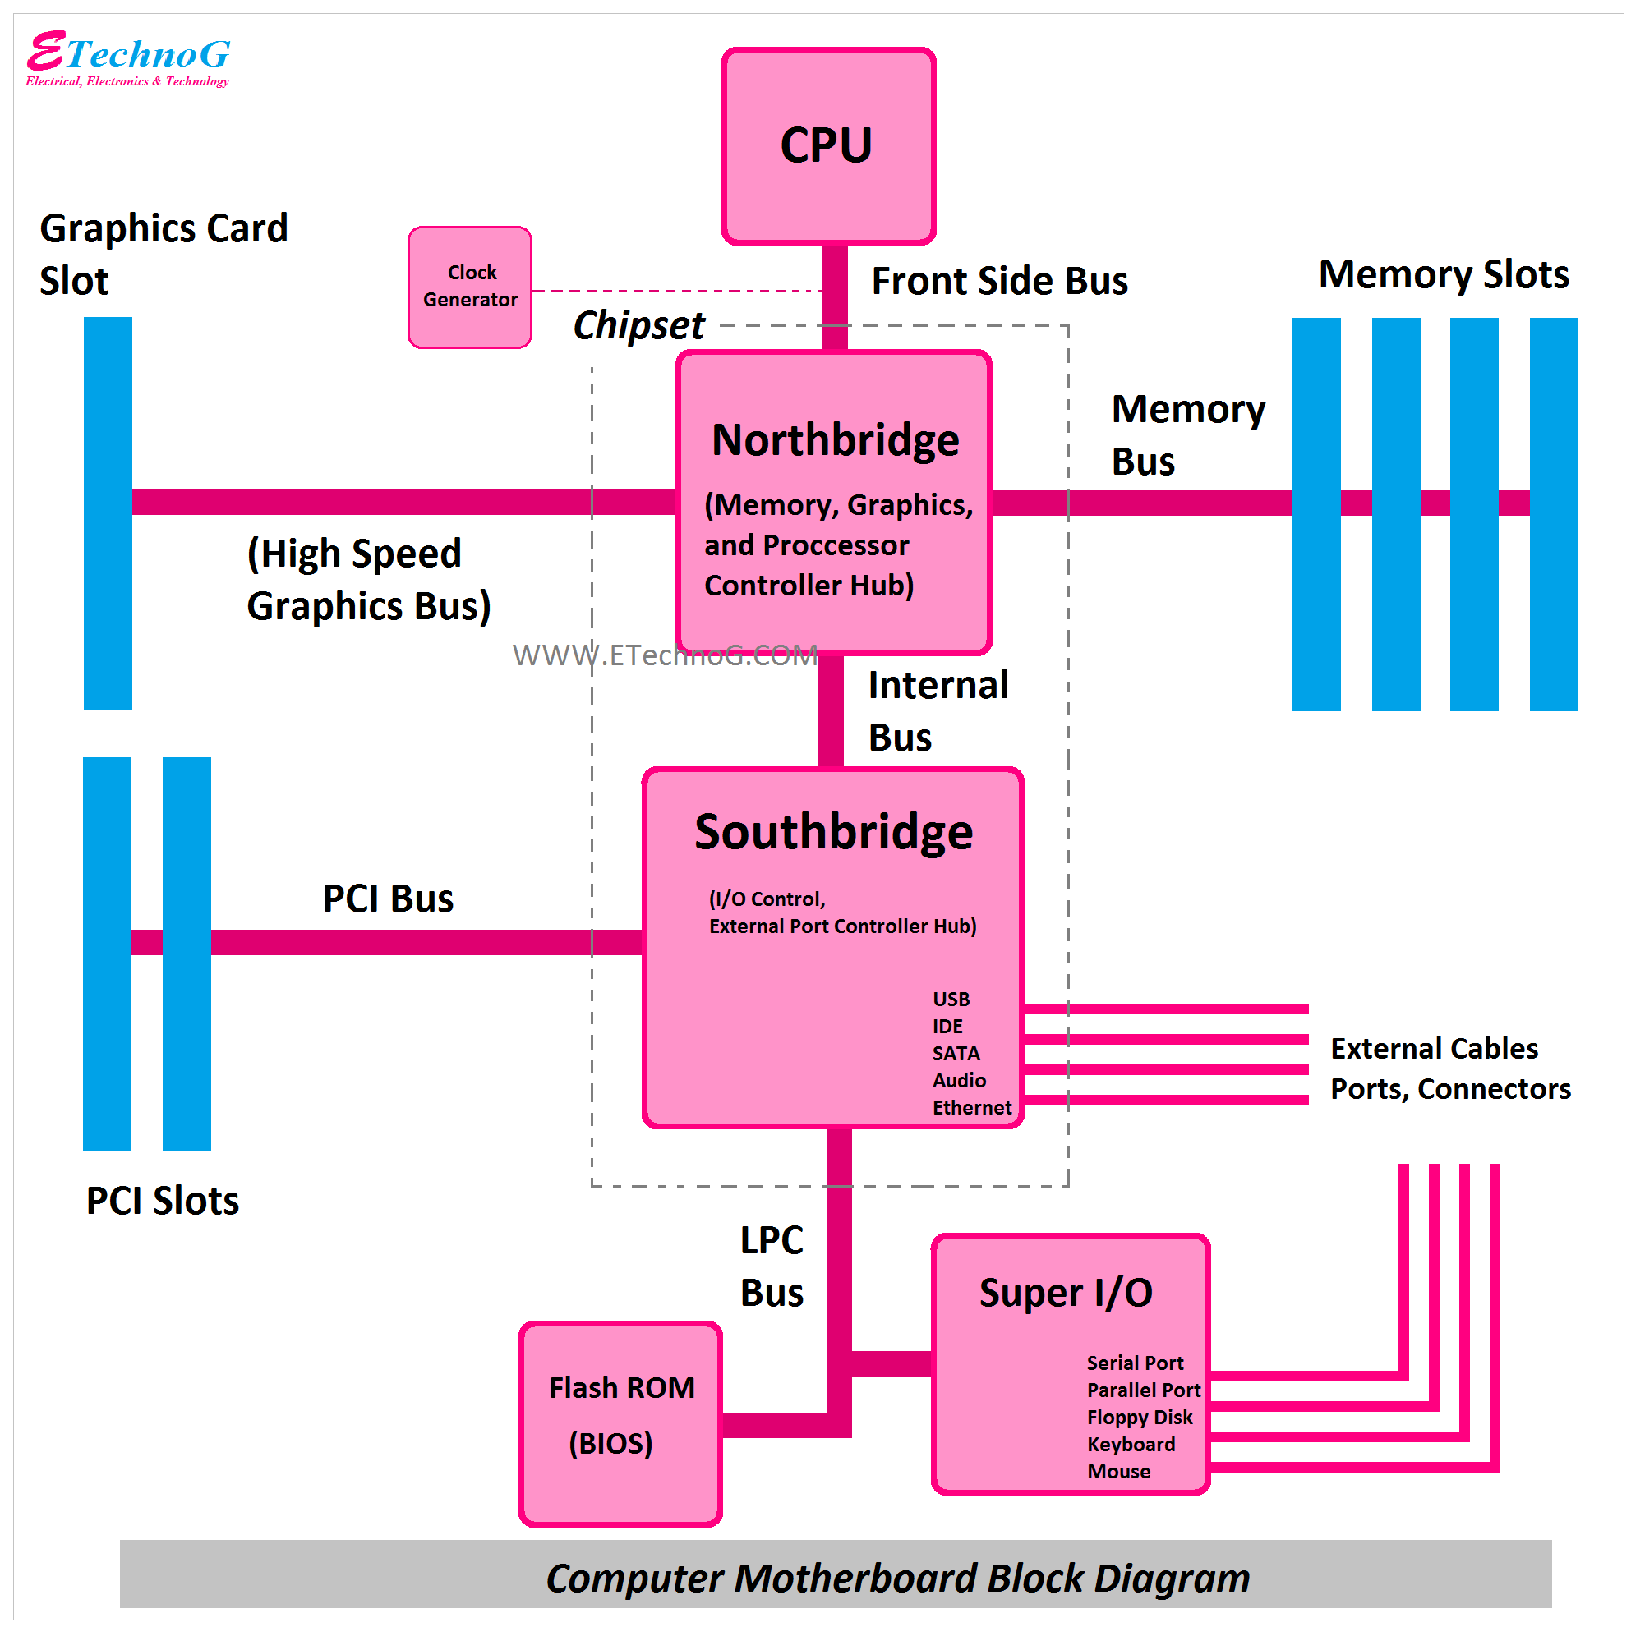

Slide 9
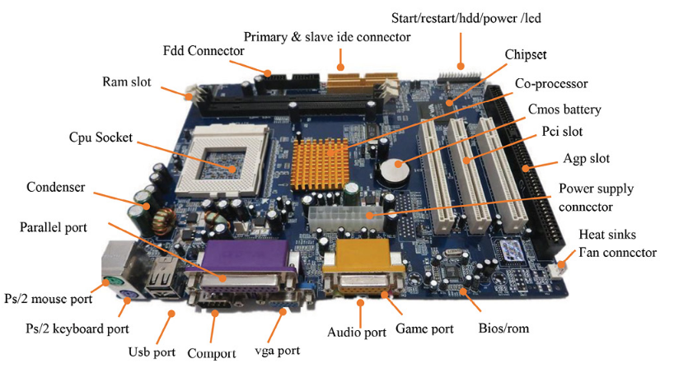

Slide 10
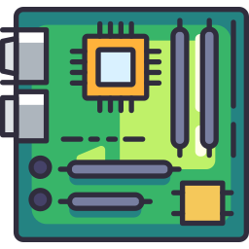
Definition and Role of a Motherboard
The motherboard is the main circuit board in a computer system that provides a physical and electrical connection between all the internal components.
It acts as a central hub, facilitating communication and data transfer among the processor, memory, storage devices, expansion cards, and other peripherals.
In essence, the motherboard is the backbone of a computer, allowing all the components to work together seamlessly.

Slide 11
Importance of the Motherboard in a Computer System
The motherboard plays a crucial role in the overall performance and functionality of a computer system.
It not only houses and connects all the essential components but also determines the system's compatibility, expandability, and overall capabilities.
A well-designed and high-quality motherboard can enhance system stability, improve data transfer speeds, and provide features for customization and future upgrades.

Slide 12
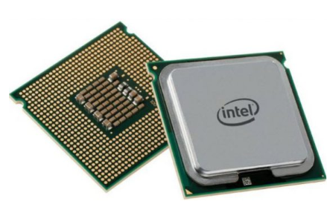
Basic Components of a Motherboard - CPU Socket
The CPU socket, also known as the processor socket, is a specialized slot or a physical interface on the motherboard that allows the installation and connection or designed to accommodate the computer's central processing unit (CPU).
It provides both Mechanical Support/ Physical Connection, Electrical Connections and Thermal Interface for the CPU, allowing it to communicate with other components.
When installing a CPU, the following steps generally take place: CPU Compatibility, CPU Alignment, CPU Placement, and Locking Mechanism.
The CPU socket determines the type and model of processors that can be installed on the motherboard.

Slide 13
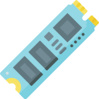
Basic Components of a Motherboard - Memory Slots
Memory slots, or DIMM slots (Dual Inline Memory Module), are used to install random access memory (RAM) modules onto the motherboard.
These slots determine the type of RAM supported (e.g., DDR4, DDR3) and the maximum amount of memory that can be installed.
The memory modules inserted into these slots directly affect the system's overall performance and multitasking capabilities.

Slide 14
Basic Components of a Motherboard - Expansion Slots (PCI Slots)
Expansion slots are used to add extra functionality and expand the capabilities of a computer system.
Common types of expansion slots include PCI Express (PCIe) and Peripheral Component Interconnect (PCI) slots.
PCI slots found on motherboards that allow the installation of additional hardware devices.
PCI slots are typically used to connect expansion cards such as network adapters, sound cards, graphics cards, and various other peripherals.

Slide 15
Basic Components of a Motherboard - Expansion Slots (PCI Slots)
The PCI bus, or PCI local bus, is the data pathway that connects the PCI slots to the rest of the computer system.
It serves as a communication channel for the data exchanged between the PCI devices (installed in the PCI slots) and the CPU (Central Processing Unit) or other parts of the motherboard.
These slots provide a high-speed connection between the expansion card and the motherboard, enabling data transfer and communication between the card and the computer's processor.
The PCI bus provides a standardized and efficient method for transmitting data between the devices, with a dedicated bus controller managing the data flow.

Slide 16
Basic Components of a Motherboard - LPC bus
The LPC bus (Low Pin Count bus) is a type of bus used in computer systems for low-speed peripheral communication.
It is typically found on older motherboards and is primarily used for connecting low-bandwidth devices such as the BIOS (Basic Input/Output System) chip, super I/O (Input/Output) devices, and legacy interfaces like the serial and parallel ports.
The LPC bus uses a LPC interface controller to manage the communication between the devices and the rest of the system.
The LPC bus uses a heavily multiplexed four-bit-wide bus operating at four times the clock speed (33.3 MHz) to transfer addresses and data with similar performance.

Slide 17
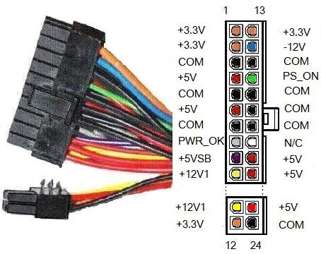
Basic Components of a Motherboard - Power Connectors
Power connectors on the motherboard provide the necessary electrical power to the components.
The primary power connector, usually a 24-pin ATX connector, supplies power to the motherboard itself.
Additional power connectors, such as the 4-pin or 8-pin CPU power connector, deliver power specifically to the CPU.
24-pin ATX connector

Slide 18
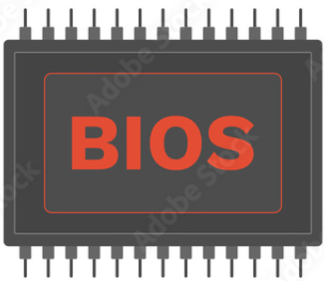
Basic Components of a Motherboard - BIOS Chip
The Basic Input/Output System (BIOS) chip stores firmware that initializes the computer system during startup.
It contains the instructions necessary to start the hardware and load the operating system.
In modern motherboards, the BIOS chip has been largely replaced by Unified Extensible Firmware Interface (UEFI) firmware, which offers enhanced features and a graphical interface.

Slide 19
BIOS and UEFI Features
The motherboard's BIOS (Basic Input/Output System) or UEFI (Unified Extensible Firmware Interface) firmware provides essential system configuration and initialization functions.
Advanced motherboards offer additional BIOS/UEFI features, such as overclocking settings, fan control, secure boot options, and hardware monitoring.
These features allow users to customize and optimize their system's performance and functionality.

Slide 20
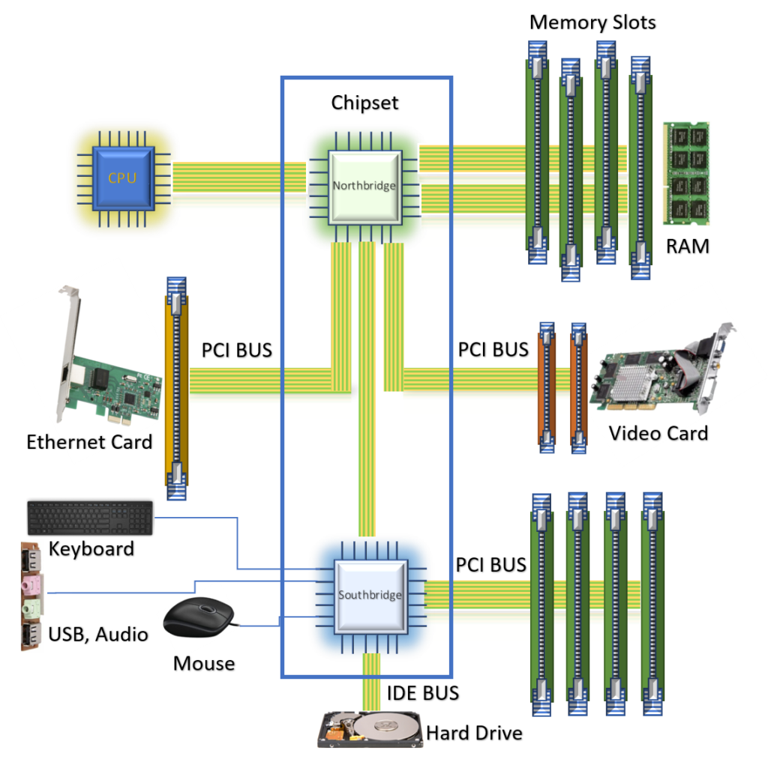
Basic Components of a Motherboard - Chipset
The chipset is a collection of integrated circuits (chips) on the motherboard that controls and coordinates data flow between various components.
It includes the Northbridge and Southbridge chips, which manage functions like memory access, peripheral connections, and data transfer between the CPU, RAM, and other peripherals.

Slide 21
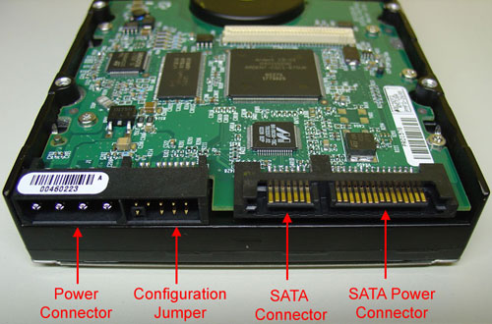
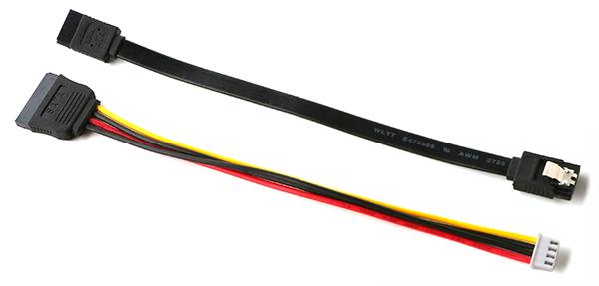
Basic Components of a Motherboard - Storage Interfaces
The motherboard provides various storage interfaces to connect storage devices such as hard disk drives (HDDs), solid-state drives (SSDs), and optical drives.
Common storage interfaces include Serial ATA (Serial Advanced Technology Attachment-SATA), which is used for connecting hard drives and SSDs, and M.2 slots, which support high-speed SSDs.

Slide 22

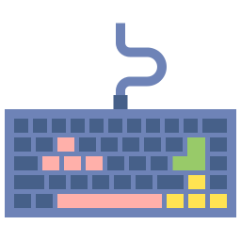
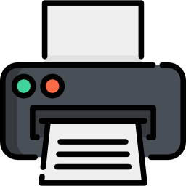
Basic Components of a Motherboard - Input/output (I/O) Ports
I/O ports on the motherboard enable communication between the computer system and external devices.
These ports include USB ports, audio jacks, Ethernet ports, HDMI or DisplayPort connectors, and other specialized ports like PS/2, VGA, or Thunderbolt.
I/O ports facilitate connections to peripherals such as keyboards, mice, monitors, printers, and network devices.

Slide 23
Types of Motherboards

Slide 24
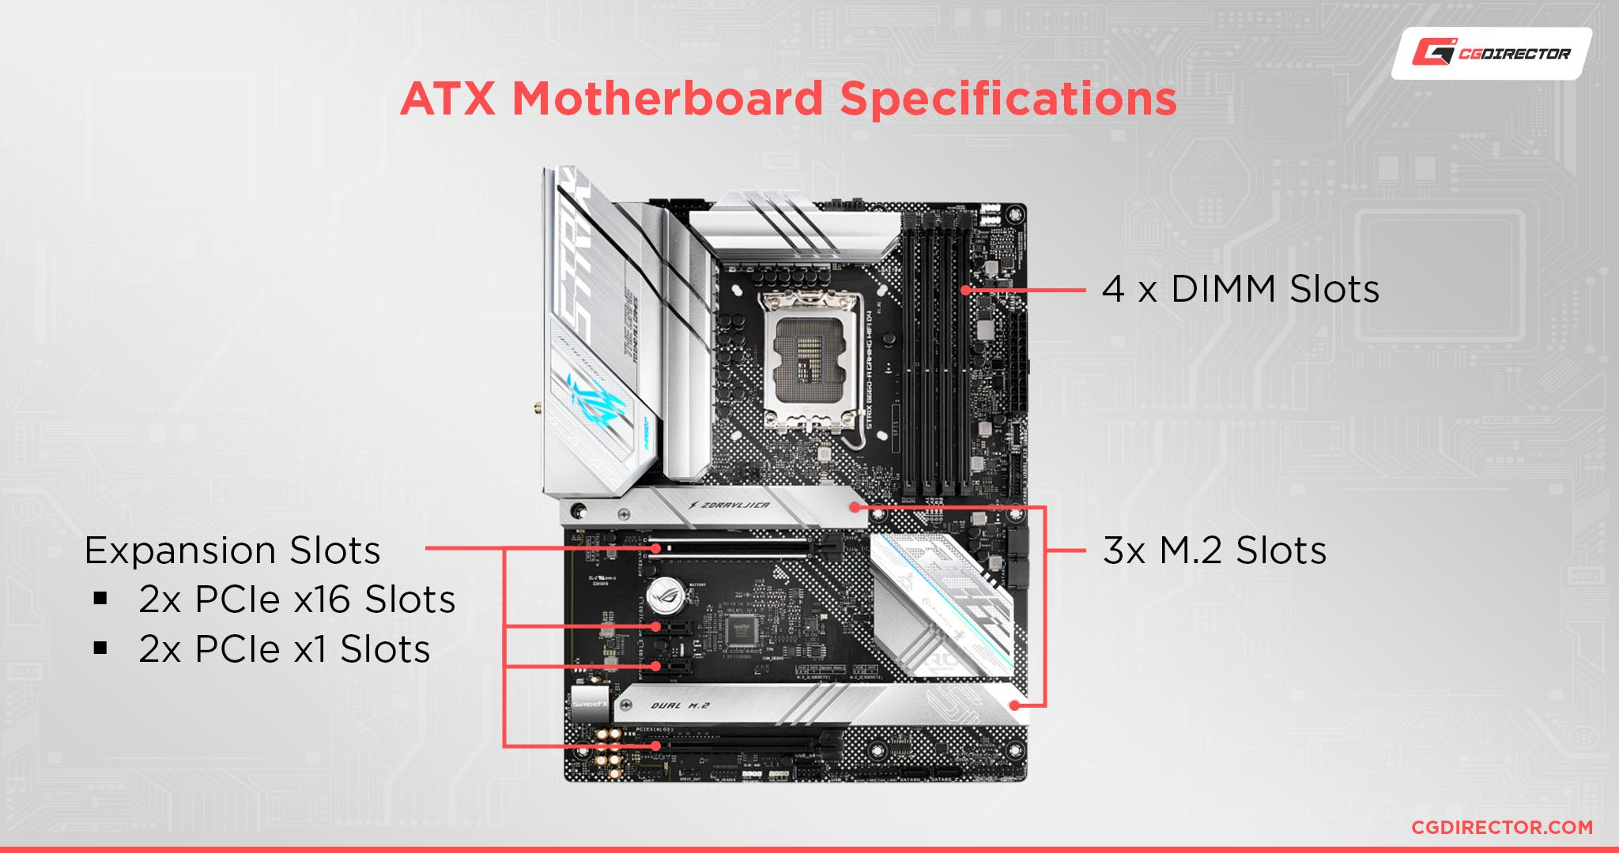
Form Factors - ATX
Motherboards come in different form factors, which determine their physical size, shape, and compatibility with computer cases.
ATX (Advanced Technology eXtended) motherboards are the most prevalent form factor used in desktop computers.
They offer a standard size and layout, providing ample expansion slots and connectors.
ATX motherboards are suitable for most consumer and gaming systems, offering a good balance between features and size.
ATX is a motherboard and power supply configuration specification, patented by
David Dent in 1995 at Intel, to improve on previous de facto standards like the AT design.

Slide 25
Form Factors - Micro-ATX (mATX)
Micro-ATX motherboards are smaller than ATX but still provide a decent number of expansion slots and connectors.
They are a popular choice for compact desktops or budget-oriented systems.
Micro-ATX motherboards are often compatible with ATX cases, making them a flexible option for different build sizes.

Slide 26
Form Factors - Mini-ITX
Mini-ITX motherboards are the smallest mainstream form factor available.
They are designed for compact and space-constrained systems.
Despite their small size, Mini-ITX motherboards can still accommodate a decent number of components, but with fewer expansion slots.
They are commonly used in HTPCs (Home Theater PCs) or small form factor gaming rigs.

Slide 27
Specialized Motherboards
Server motherboards:
A server motherboard is a specialized type of motherboard designed for use in servers and high-performance computing environments.
Server motherboards typically have features and capabilities that are optimized for server applications, such as increased processing power, memory capacity, and expansion options.
Here are some common features and considerations when it comes to server motherboards: multiple Processor Support, high-speed Network Connectivity, more-Memory Capacity, Expansion Slots, Storage Options.
They offer features like support for multiple CPUs, extensive RAM capacity, and multiple expansion slots for networking or storage.
Server motherboards prioritize stability, reliability, and scalability, making them ideal for hosting websites, running databases, or managing large-scale data centers.

Slide 28
Specialized Motherboards (cont.)
Gaming motherboards:
Gaming motherboards are tailored for gamers and enthusiasts seeking high-performance systems.
They often feature advanced overclocking capabilities, reinforced power delivery systems, enhanced audio and networking solutions, and multiple graphics card slots.
Gaming motherboards also incorporate aesthetic elements like RGB lighting and design accents to appeal to gamers.

Slide 29
Specialized Motherboards (cont.)
Workstation motherboards:
Workstation motherboards target professionals working with resource-intensive tasks like 3D modeling, video editing, or scientific simulations.
These motherboards provide support for high-end CPUs, large amounts of RAM, multiple storage options, and workstation-grade graphics cards.
Workstation motherboards prioritize stability, data integrity, and compatibility with professional software.

Slide 30
Specialized Motherboards (cont.)
Server motherboard, Gamming motherboard and Workstation motherboards:
Overall, server motherboards prioritize reliability, scalability, and remote management capabilities. Gaming motherboards emphasize high-performance gaming features and overclocking. Workstation motherboards cater to professional applications with powerful hardware, expandability, and compatibility with workstation-specific peripherals and software.
It's important to note that these distinctions are not always absolute, and there can be some overlap in features between different types of motherboards. Manufacturers may offer models that cater to specific needs and blur the lines between categories.

Slide 31
Features and Functionality

Slide 32
Processor Support and Compatibility
Motherboards are designed to support specific processor types and socket configurations.
The processor socket on a motherboard determines the compatibility with different CPU models.
It is crucial to ensure that the motherboard supports the desired processor series and socket type to ensure proper functionality and performance.

Slide 33
Memory Support and Capacity
Motherboards have a maximum memory capacity and support specific types of RAM modules.
The memory slots on the motherboard determine the type and amount of RAM that can be installed.
It is important to consider the maximum supported memory capacity and compatible RAM types (e.g., DDR4, DDR3) to meet the system's performance and multitasking needs.

Slide 34
Expansion Capabilities
Expansion slots on the motherboard allow for the installation of additional hardware components, such as graphics cards, sound cards, or network adapters.
The number and type of expansion slots (e.g., PCIe, PCI) determine the system's expandability.
Consider the need for future upgrades and expansion when selecting a motherboard with adequate expansion capabilities.

Slide 35
Storage Interfaces and RAID Support
Motherboards provide various storage interfaces, such as SATA (Serial ATA) and M.2 slots, to connect storage devices like hard drives and solid-state drives.
The presence of multiple storage connectors and RAID (Redundant Array of Independent Disks) support allows for flexible storage configurations, including data redundancy and increased performance.

Slide 36
Audio and Video Capabilities
Motherboards often include integrated audio and video solutions.
The audio capabilities can range from basic stereo output to high-definition audio with dedicated audio processing components.
Video capabilities can include onboard graphics with support for multiple display outputs or the ability to handle discrete graphics cards for enhanced gaming or multimedia performance.

Slide 37
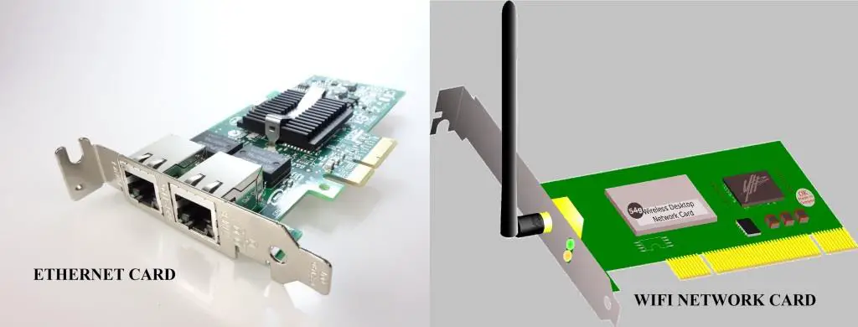
Networking Capabilities
Networking capabilities on a motherboard can include integrated Ethernet ports or built-in Wi-Fi connectivity.
The networking features can vary in terms of speed (e.g., Gigabit Ethernet, Wi-Fi 6), additional network management features, and compatibility with specialized network protocols.

Slide 38
Power Delivery and Efficiency
The power delivery system on a motherboard ensures stable and efficient power distribution to the components.
High-quality motherboards often feature robust power delivery systems with multiple power phases, solid capacitors, and efficient voltage regulation.
This ensures reliable performance and facilitates overclocking capabilities for enthusiasts.

Slide 39
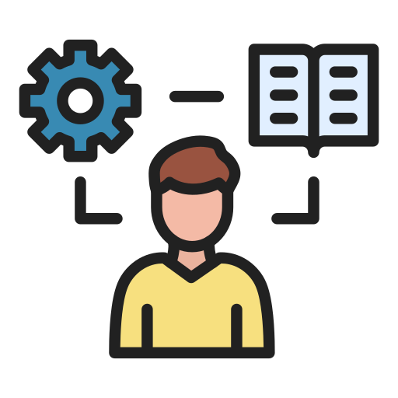
Let’s do some exercises!

Slide 40
Exercises
What is a motherboard, and what role does it play in a computer system?
What are the main components found on a typical motherboard?
Can you explain the functions and features of the CPU socket on a motherboard?
Write a short note on the Memory Slots on a motherboard.
Write a short note on the Expansion Slots on a motherboard.
How does the chipset on a motherboard contribute to its overall functionality?
What is the purpose of the BIOS (Basic Input/Output System) on a motherboard?
What role does the clock generator play in controlling the timing of signals on a motherboard?
How do different form factors (e.g., ATX, Micro ATX) affect the physical layout and size of a motherboard?

Slide 41
Exercises (cont.)
Write a short note on the following topic:
ATX (Advanced Technology eXtended) motherboards
Micro-ATX motherboards
Mini-ITX motherboards
Discuss with your classmates and write about the following specialized motherboards:
Gaming motherboards
Workstation motherboards
Server motherboards
What are the key factors to consider when choosing a motherboard for a specific computer build?
How has the evolution of motherboard technology influenced the overall performance and capabilities of computers?

Slide 42

Thanks!

